Slide 1
The Mighty Mangrove

Slide 2
The Mighty Mangrove
Ecology
01
Benefits
Hydrological Importance
02
03
Threats
Solutions
04
05

Slide 3
01
Ecology

Slide 4
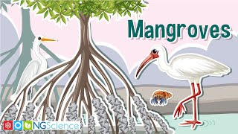
Ecology
Notes:
https://www.youtube.com/watch?v=4YiL6JRgcmk

Slide 5
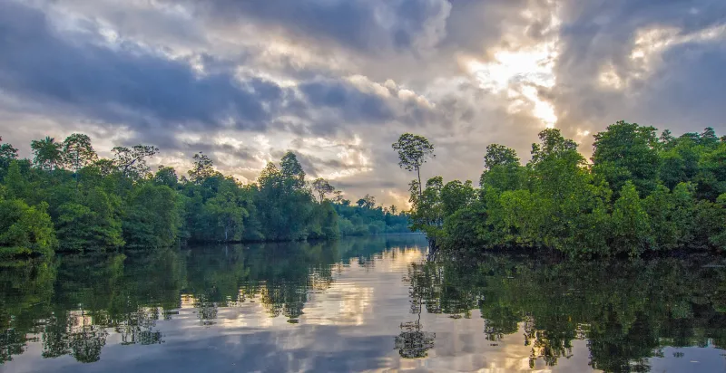
Ecology
Notes:
https://ocean.si.edu/ocean-life/plants-algae/mangroves

Slide 6
Ecology
Mangroves are found in tropical and subtropical regions
Salt-loving trees found in brackish water
In the US, they are found in Florida along the Gulf Coast to Texas
‘Mangrove’ is used to describe individual plants, while ‘mangral’ or ‘mangrove forest’ refers to the habitat
There are about 50 species of mangrove
Notes:
https://www.epa.gov/wetlands/mangrove-swamps
https://ocean.si.edu/ocean-life/plants-algae/mangroves
https://www.dpi.nsw.gov.au/__data/assets/pdf_file/0020/236234/mangroves.pdf

Slide 7
Notes:
https://ocean.si.edu/ocean-life/plants-algae/mangroves
A map of mangrove species around the world. (Deltares, 2014)

Slide 8
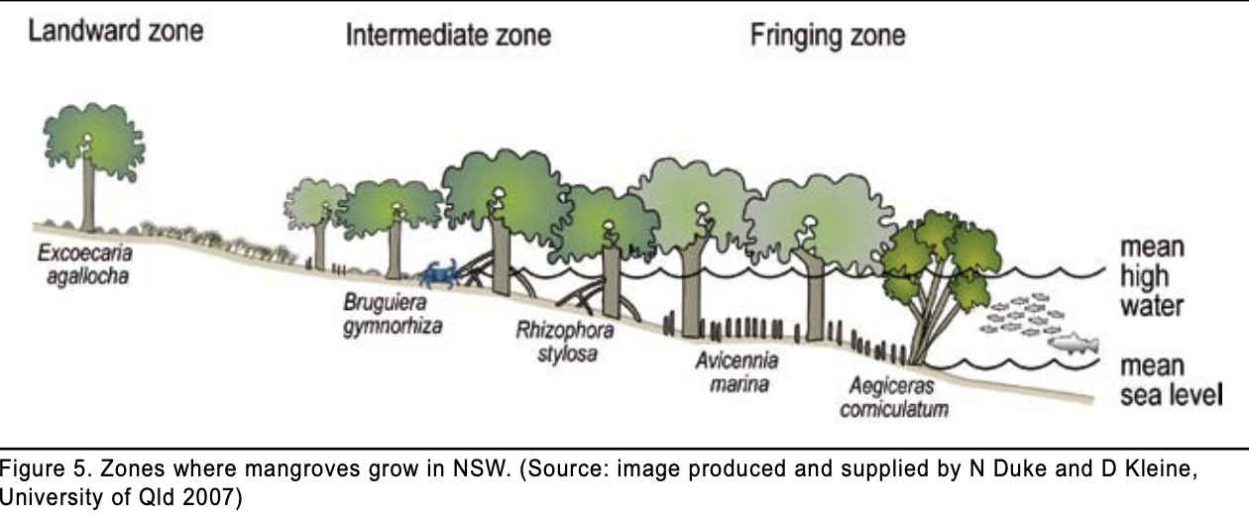
Ecology
Notes:
https://www.dpi.nsw.gov.au/__data/assets/pdf_file/0020/236234/mangroves.pdf

Slide 9
Ecology
Mangrove forests along open bays and lagoons that experience full sun are mangrove fringe. Depend on regular tides that flush leaves, twigs, and mangrove propagules out into the open ocean.
An overwash forest is similar to a fringe forest except the entire forest is an island that becomes flooded at high tide. Isolated from the mainland and terrestrial predators, it is a popular place for birds to nest.
Notes:
https://ocean.si.edu/ocean-life/plants-algae/mangroves

Slide 10
Ecology
Riverine mangrove forests are within river floodplains by the coast and are influenced by seasons. Sometimes they are inundated with fresh river water, while during summer droughts the soil can become exceptionally salty when the fresh river water is almost nonexistent.
Basin mangrove forests extend far inland and occur in inlets, deep bays, and coves.
Dwarf, or scrub, mangrove forests only attain canopy heights of less than 5 feet (1.5 meters) although they contain the same species as the other types of forest. The stunted growth is often attributed to a lack of nutrients, high salinity, and rocky soils.
Notes:
https://ocean.si.edu/ocean-life/plants-algae/mangroves

Slide 11
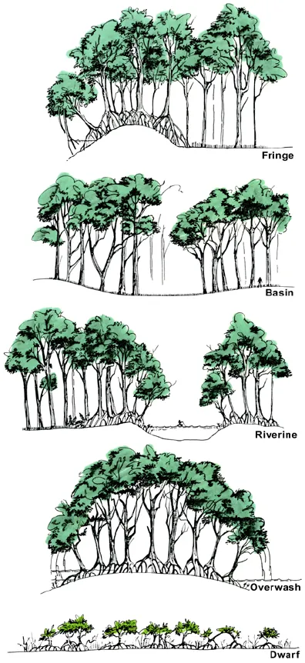
Ecology
Notes:
The five different types of mangrove forests. (modified from Lugo and Snedaker 1974)

Slide 12
Ecology
Mangrove vegetation shares several characteristics:
Salty sap
Waxy leaves to prevent saltwater penetration
Salt secreting pores in leaves
Concentration of salt in certain branches before dropping them
Root system that acts like a snorkel
Notes:
https://www.dpi.nsw.gov.au/__data/assets/pdf_file/0020/236234/mangroves.pdf

Slide 13
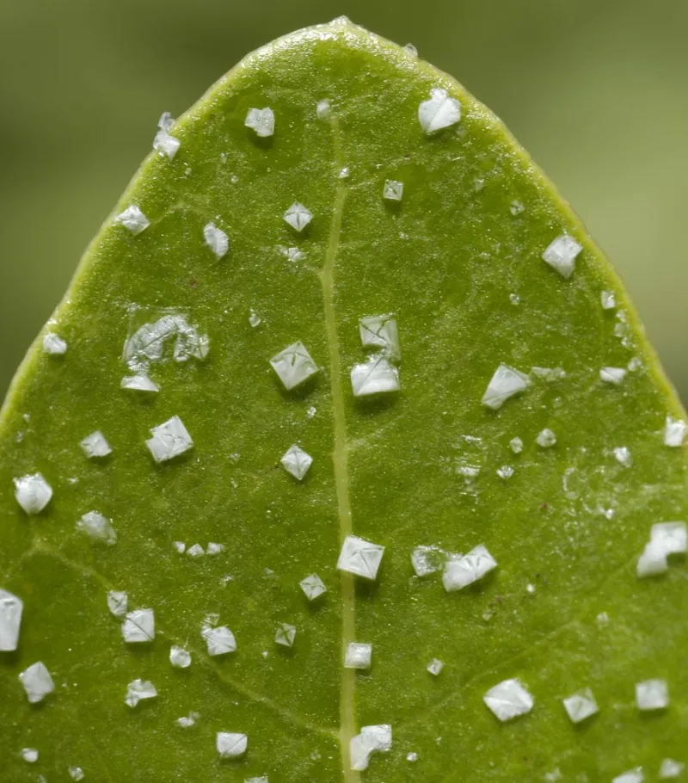
Notes:
Some mangroves, like this Avicennia germinans, get rid of excess salt from the water by excreting it through their leaves. The salt can form crystals on the leaf surface. (Ulf Mehlig via Wikimedia Commons)

Slide 14
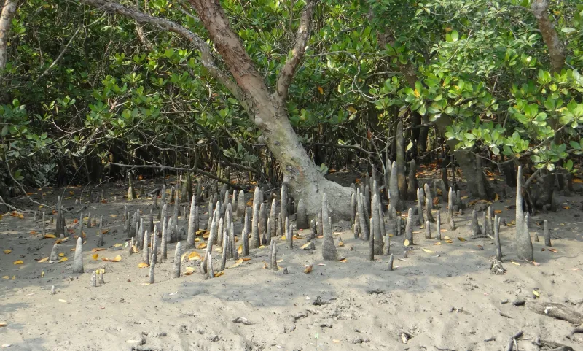
Notes:
Pneumatophores, like these cone roots, help the tree gain access to oxygen even when the roots are partially submerged. (Pixabay)

Slide 15
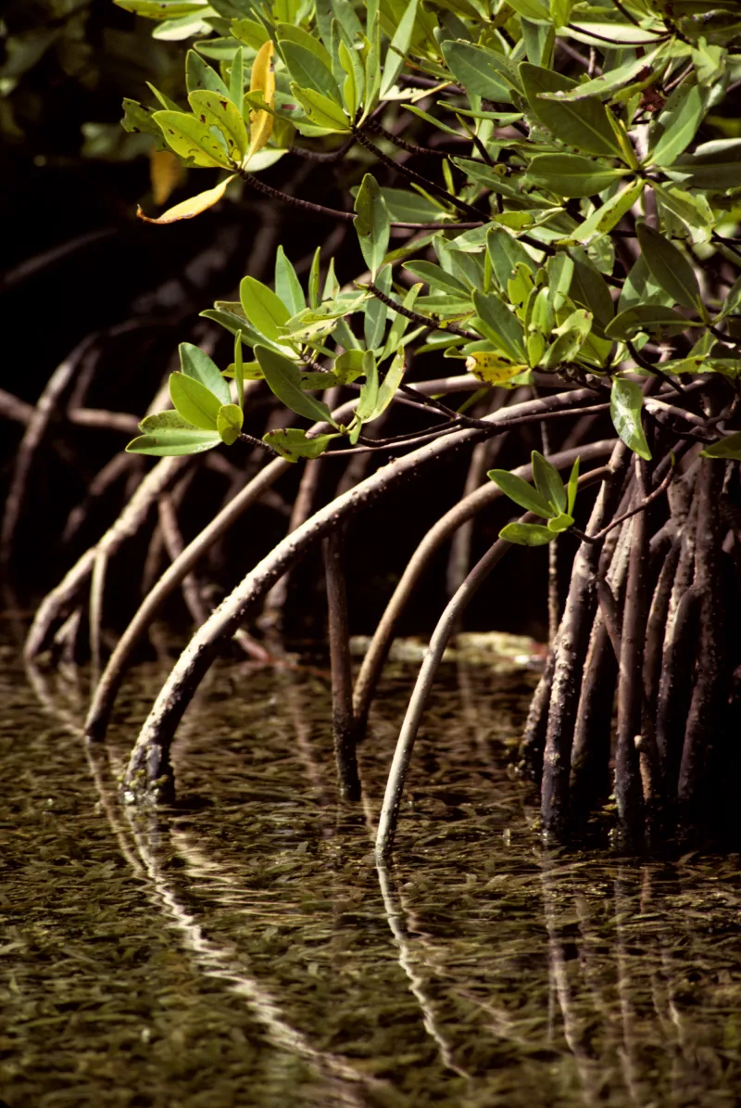
Notes:
Arching mangrove roots help keep trunks upright in soft sediments at water’s edge. (Chip Clark/Smithsonian Institution)

Slide 16
Ecology
Mangroves often found with seagrass beds and coral reefs
Mangroves trap sediment that would smother reef
Seagrass traps further debris that would smother reef
Reefs protect trees and seagrass from waves
Without any part - ecosystem would collapse
Notes:
https://www.amnh.org/explore/videos/biodiversity/mangroves/why-mangroves-matter#:~:text=At%20high%20tide%2C%20fish%20move,for%20building%20houses%20and%20boats
https://www.dcceew.gov.au/water/wetlands/publications/factsheet-wetlands-mangroves-saltmarsh

Slide 17
Ecology
Mangroves reproduce by creating propagules - floating seed pods that are carried away via currents
They eventually become waterlogged and lodge into the mud below
These can stay dormant for up to a year, depending on the species
Notes:
https://www.amnh.org/explore/videos/biodiversity/mangroves/why-mangroves-matter#:~:text=At%20high%20tide%2C%20fish%20move,for%20building%20houses%20and%20boats
https://www.dcceew.gov.au/water/wetlands/publications/factsheet-wetlands-mangroves-saltmarsh

Slide 18
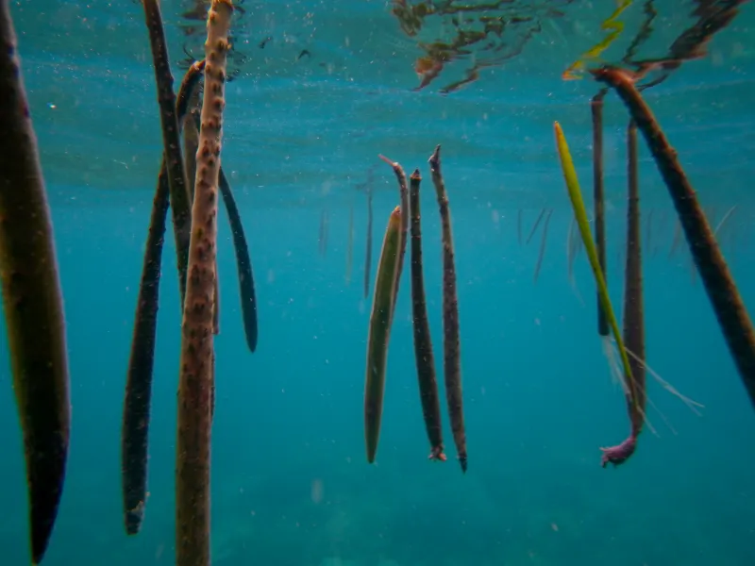
Ecology
Notes:
Floating mangrove propagules. (Brian Gratwicke, Flickr)
https://www.dcceew.gov.au/water/wetlands/publications/factsheet-wetlands-mangroves-saltmarsh

Slide 19
02
Benefits

Slide 20
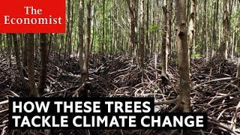
Benefits

Slide 21
Benefits
Mangroves provide shelter to an estimated 75% of commercially caught fish as juveniles
They are home to thousands of species - aquatic and terrestrial, including monkeys, Bengal tigers, and barnacles
The leaves that fall and biodegrade create a lush ecosystem below
Notes:
https://www.amnh.org/explore/videos/biodiversity/mangroves/why-mangroves-matter#:~:text=At%20high%20tide%2C%20fish%20move,for%20building%20houses%20and%20boats
https://www.dcceew.gov.au/water/wetlands/publications/factsheet-wetlands-mangroves-saltmarsh

Slide 22
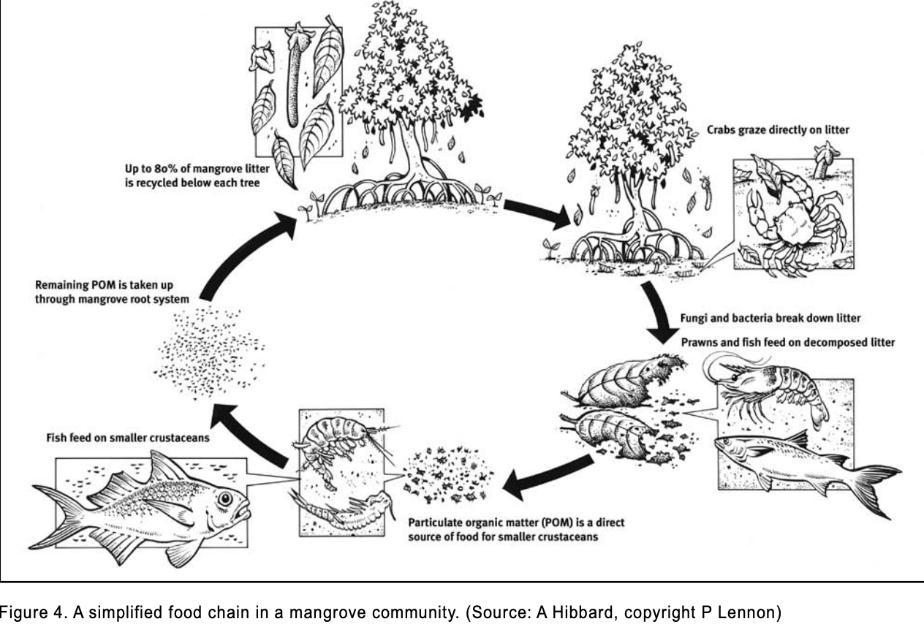
Ecology
]
Notes:
https://www.dpi.nsw.gov.au/__data/assets/pdf_file/0020/236234/mangroves.pdf

Slide 23
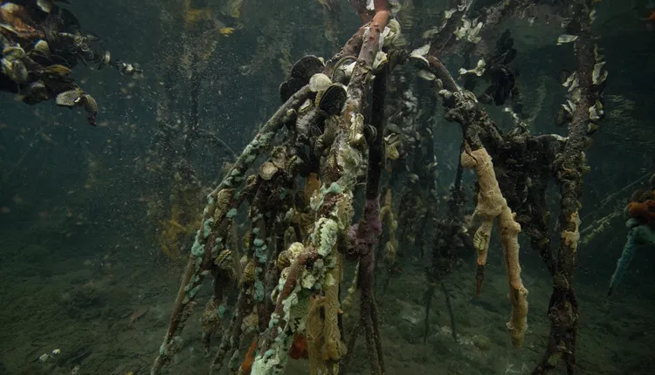
Ecology
]
Notes:
Mangrove roots provide support for filter-feeders like mussels, oysters, and barnacles. (Chip Clark/Smithsonian Institution)

Slide 24
Benefits
Collecting sediment stabilizes the coastline against erosion
Thickets of mangroves buffer the land from wind and wave
Low tide offers mud flats while high tide offers fishing grounds - both vital for local populations
Mangroves are a carbon sink - in Australia, an estimated 66x carbon capture and 5x carbon storage compared to forests
Notes:
https://www.amnh.org/explore/videos/biodiversity/mangroves/why-mangroves-matter#:~:text=At%20high%20tide%2C%20fish%20move,for%20building%20houses%20and%20boats
https://www.dcceew.gov.au/water/wetlands/publications/factsheet-wetlands-mangroves-saltmarsh

Slide 25
Benefits
A 2006 UN study estimates that mangroves provide US $200,000 - 900,000 per sq. km. in services including fisheries, protection, building materials, tourism, recreation and water quality improvement.
Notes:
https://www.dpi.nsw.gov.au/__data/assets/pdf_file/0020/236234/mangroves.pdf

Slide 26
03
Hydrology

Slide 27
Hydrology
The complex root system filters both salt and freshwater for nitrites and phosphates
Notes:
https://www.amnh.org/explore/videos/biodiversity/mangroves/why-mangroves-matter#:~:text=At%20high%20tide%2C%20fish%20move,for%20building%20houses%20and%20boats

Slide 28
04
Threats

Slide 29
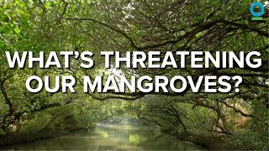
Threats
Notes:
https://youtu.be/70NtA-K82bI?si=pOlPT54wZID90vL0

Slide 30
Threats
Major threats include:
reclamation for development—including for housing, transport and other infrastructure
shore protection works such as sea walls
changes to freshwater and tidal flows and drainage to reclaim land
uncontrolled stock access to saltmarshes
off-road vehicles and pedestrian traffic
rubbish and pollution
pressure by nearby communities for mosquito control
weed invasion.
Notes:
https://www.dcceew.gov.au/water/wetlands/publications/factsheet-wetlands-mangroves-saltmarsh

Slide 31
Threats
7% of the world’s mangroves are in Australia, and 17% have been destroyed since European settlement
Mangroves will disappear from the Caribbean within the next 60 years at the current rate
40% of mangroves have been lost worldwide, 66 sq. km. are lost yearly
As sea levels rise, mangroves may begin “migrating” inshore, impacting local river ecosystems
Mangroves are often cleared to create scenic beaches, resorts, or fish farms.
Notes:
https://www.dcceew.gov.au/water/wetlands/publications/factsheet-wetlands-mangroves-saltmarsh
https://caribbeanbiodiversityfund.org/blog/unveiling-the-marvels-of-mangrove-forests-the-mighty-coastal-wetlands/
https://www.dpi.nsw.gov.au/__data/assets/pdf_file/0020/236234/mangroves.pdf

Slide 32
Threats
A 2024 IUCN study found that up to 50% of mangroves are threatened, globally
Mangroves depend on mud build up, which isn’t happening fast enough as sea levels rise
Invasive species are often found to disrupt mangroves
Sea grasses can take up space, antelopes and livestock graze
Notes:
https://ocean.si.edu/ocean-life/plants-algae/mangroves

Slide 33
Threats
Shrimp farming is one of the largest threats - has caused 35% of total loss of mangroves
Waste left over from shrimp farming creates a toxic environment
Shrimp farms only last 2 - 5 years before being shut down
Contrary to popular belief, shrimp farms do not bolster local economies as nearly all of the shrimp are exported and jobs are only temporary
Notes:
https://www.wwt.org.uk/news-and-stories/news/wetland-habitat-fact-file-mangroves
https://ocean.si.edu/ocean-life/plants-algae/mangroves

Slide 34
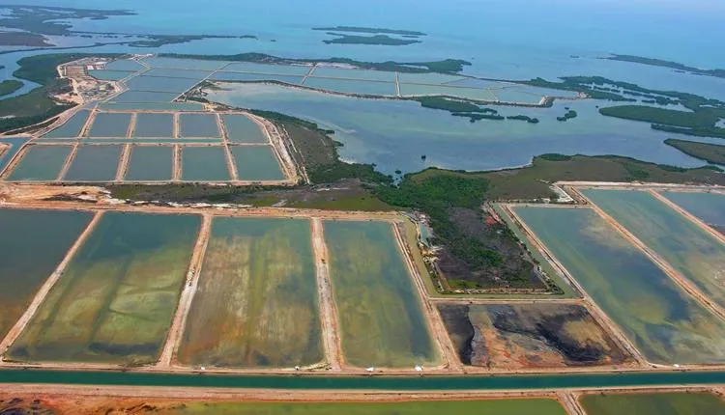
Threats
Notes:
https://ocean.si.edu/ocean-life/plants-algae/mangroves

Slide 35
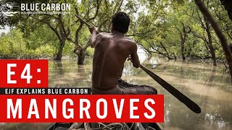
Threats
Notes:
https://youtu.be/HnYOFvhMV6Q?si=H3FyZwOuLJ-Jl2Dy

Slide 36
05
Solutions

Slide 37
Solutions
establishing buffer zones between coastal habitats and adjacent development
identifying and protecting areas where coastal habitats can retreat with sea level rise
fencing along the intertidal zone to prevent livestock access
removing barriers to restore natural tidal flows
undertaking rehabilitation projects to restore habitats
designing waterfront structures such as boat ramps jetties and pathways to avoid or minimise impacts on water flows
Notes:
https://www.dcceew.gov.au/water/wetlands/publications/factsheet-wetlands-mangroves-saltmarsh
https://www.dpi.nsw.gov.au/__data/assets/pdf_file/0020/236234/mangroves.pdf

Slide 38
Solutions
avoiding driving, walking or biking through saltmarsh areas
avoiding stormwater discharges into coastal habitats
disposing of rubbish and chemicals responsibly
removing weeds.
Notes:
https://www.dcceew.gov.au/water/wetlands/publications/factsheet-wetlands-mangroves-saltmarsh
https://www.dpi.nsw.gov.au/__data/assets/pdf_file/0020/236234/mangroves.pdf

Slide 39
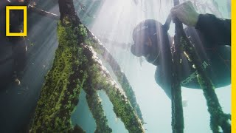
Solutions
Notes:
https://youtu.be/rIXeDlgx5Rc?si=neV2zc0vr7uFZIEn

Slide 40
Citations
YouTube. (2021, March 21). Mangroves - Guardians of the Coast. YouTube. https://www.youtube.com/watch?v=4YiL6JRgcmk \
Smithsonian Ocean. (2025, February 28). Mangroves. Smithsonian Ocean. https://ocean.si.edu/ocean-life/plants-algae/mangroves
Mangrove Swamps | US EPA. (2025, February 5). US EPA. https://www.epa.gov/wetlands/mangrove-swamps
A map of mangrove species around the world. (Deltares, 2014)
Stewart, M., & Fairfull, S. (2008). WHAT ARE MANGROVES? In Mangroves (Primefact No. 746). https://www.dpi.nsw.gov.au/__data/assets/pdf_file/0020/236234/mangroves.pdf
The five different types of mangrove forests. (modified from Lugo and Snedaker 1974)

Slide 41
Citations
Some mangroves, like this Avicennia germinans, get rid of excess salt from the water by excreting it through their leaves. The salt can form crystals on the leaf surface. (Ulf Mehlig via Wikimedia Commons)
Pneumatophores, like these cone roots, help the tree gain access to oxygen even when the roots are partially submerged. (Pixabay)
Arching mangrove roots help keep trunks upright in soft sediments at water’s edge. (Chip Clark/Smithsonian Institution)
Coastal wetlands - Mangroves and saltmarshes - DCCEEW. (2021, October 3). https://www.dcceew.gov.au/water/wetlands/publications/factsheet-wetlands-mangroves-saltmarsh
Floating mangrove propagules. (Brian Gratwicke, Flickr)
The Economist. (2020, March 9). Mangroves: how they help the ocean [Video]. YouTube. https://www.youtube.com/watch?v=sKg-WuUG0ac

Slide 42
Citations
Mangrove roots provide support for filter-feeders like mussels, oysters, and barnacles. (Chip Clark/Smithsonian Institution)
Conservation International. (2023, July 25). What’s threatening our mangroves? [Video]. YouTube. https://www.youtube.com/watch?v=70NtA-K82bI
Mangroves | The incredible surviving wetland forests. (n.d.). WWT. https://www.wwt.org.uk/news-and-stories/news/wetland-habitat-fact-file-mangroves
Environmental Justice Foundation. (2021, March 22). Blue carbon | Mangroves: the mighty forests that play a HUGE role in fighting climate change [Video]. YouTube. https://www.youtube.com/watch?v=HnYOFvhMV6Q
National Geographic. (2020, May 20). Measuring Mangroves | Explorers in the Field [Video]. YouTube. https://www.youtube.com/watch?v=rIXeDlgx5Rc

Slide 43
Thanks!
Created by Learning Endeavors
Please keep this slide as attribution

